Slide 1
07. Flow of Control: Branching
[ITP20003] Java Programming
Notes:
‹#›

Slide 2
Agenda
The if-else statement
The type boolean
The switch statement

Slide 3
Flow of Control
Flow of control is the order in which a program performs actions.
By default, the order has been sequential.
A branching statement chooses between two or more possible actions.
A loop statement repeats an action until a stopping condition occurs.
➔ Learn it in the next class

Slide 4
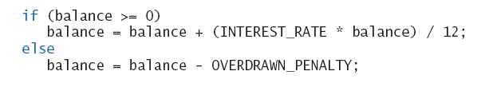
The if-else Statement
A branching statement that chooses between two possible actions.
Syntax
if (Boolean_Expression)
Statement_1
[else // else part can be omitted
Statement_2]
Ex)

Slide 5
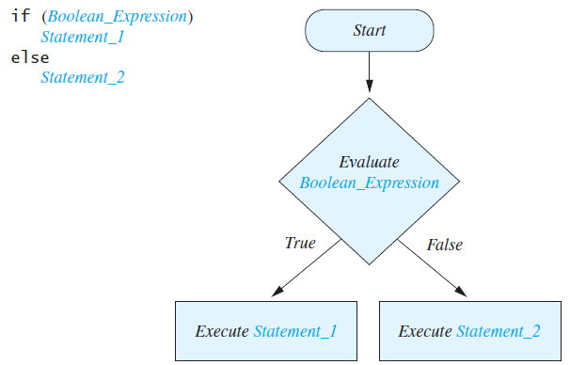
The if-else Statement

Slide 6
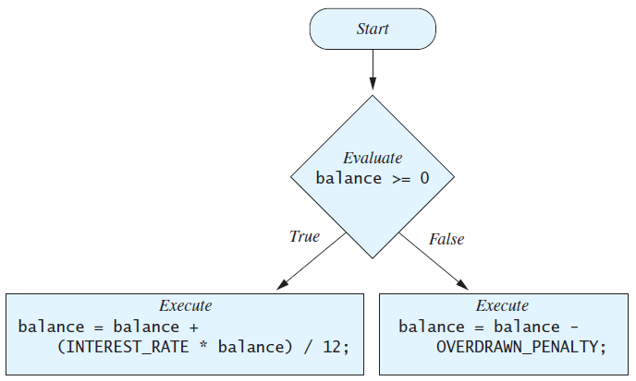
The if-else Statement
Ex) Calculating balance of a bank account

Slide 7
BankBalance
import java.util.Scanner;
public class BankBalance
{
public static final double OVERDRAWN_PENALTY = 8.00;
public static final double INTEREST_RATE = 0.02; // 2% annually
public static void main (String [] args)
{
double balance;
System.out.print ("Enter your checking account balance: $");
Scanner keyboard = new Scanner (System.in);
balance = keyboard.nextDouble ();
System.out.println ("Original balance $" + balance);
if (balance >= 0)
balance = balance + (INTEREST_RATE * balance) / 12;
else
balance = balance - OVERDRAWN_PENALTY;
System.out.print ("After adjusting for one month ");
System.out.println ("of interest and penalties,");
System.out.println ("your new balance is $" + balance);
}
}

Slide 8
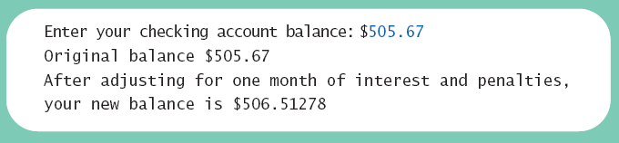
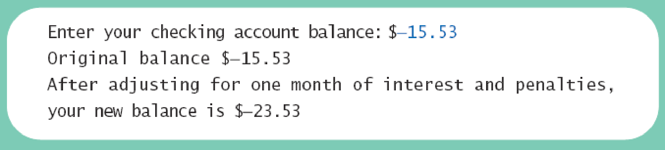
The if-else Statement

Slide 9
Compound Statements
To include multiple statements in a branch, enclose the statements in braces.
if (count < 3)
{
total = 0;
count = 0;
}
or
if (count < 3) {
total = 0;
count = 0;
}

Slide 10
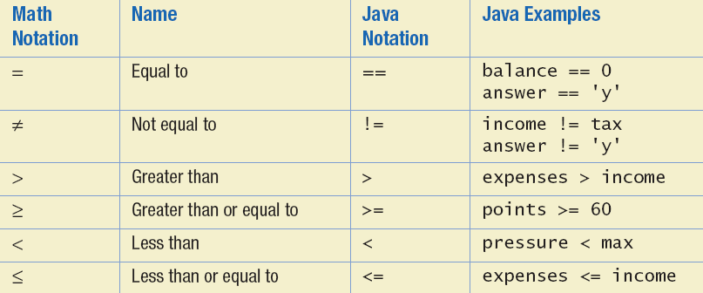
Boolean Expressions
The value of a boolean expression is either true or false.
Examples
time < limit
balance <= 0
Comparison operators

Slide 11
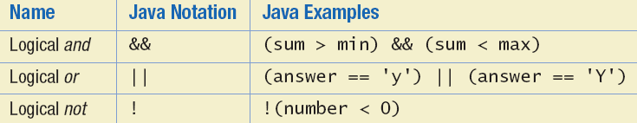
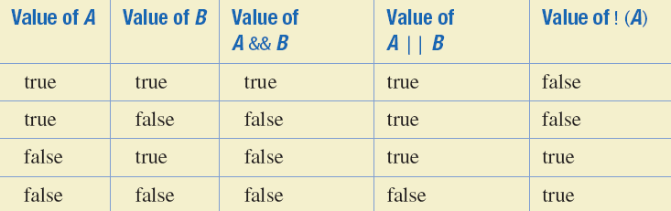
Boolean Operators

Slide 12
Compound Boolean Expressions
Examples)
if ((score > 0) && (score <= 100))
…
if ((quantity > 5) || (cost < 10))
...
Wrong example
if (0 < score <= 100)
Note! & and | are used for other purpose (bitwise and/or)

Slide 13
Exclusive OR Operator
XOR (^)
Allows one or the other, but not both to be true.
true ^ true = false
true ^ false = true
false ^ true = true
false ^ false = false

Slide 14
Using == Operator
== is appropriate for determining if two integers or characters have the same value.
if (a == 3)
where a is an integer type
== is not appropriate for determining if two floating points values are equal. Use < and some appropriate tolerance instead.
if (Math.abs(b - c) < epsilon)
where b, c, and epsilon are floating point types

Slide 15
Using == Operator
== is not appropriate for determining if two objects have the same value.
if (s1 == s2), where s1 and s2 refer to strings, determines only if s1 and s2 refer the a common memory location.
Ex)
public class Test {
public static void main(String args[]){
Scanner keyboard = new Scanner(System.in);
String s1 = keyboard.nextLine(); // user types “Hello”
String s2 = keyboard.nextLine(); // user types “Hello”
System.out.println("s1 = " + s1);
System.out.println("s2 = " + s2);
System.out.println("Expression s1 == s2 is " + (s1==s2)); }
}

Slide 16
Using == Operator
== is not appropriate for determining if two objects have the same value.
if (s1 == s2), where s1 and s2 refer to strings, determines only if s1 and s2 refer the a common memory location.
Ex)
public class Test {
public static void main(String args[]){
Scanner keyboard = new Scanner(System.in);
String s1 = keyboard.nextLine(); // user types “Hello”
String s2 = keyboard.nextLine(); // user types “Hello”
System.out.println("s1 = " + s1);
System.out.println("s2 = " + s2);
System.out.println("Expression s1 == s2 is " + (s1==s2)); }
}
s1 = Hello
s2 = Hello
Expression s1 == s2 is false

Slide 17
String Comparison
To test the equality of objects of class String, use method equals.
String.equals(other_String)
Ex)
s1.equals(s2)
or
s2.equals(s1)
To test for equality ignoring case, use method equalsIgnoreCase.
String.equalsIgnoreCase(Other_String)
Ex) "Hello".equalsIgnoreCase("hello")

Slide 18
Testing Strings for Equality
import java.util.Scanner;
public class StringEqualityDemo
{
public static void main (String [] args)
{
String s1, s2;
System.out.println ("Enter two lines of text:");
Scanner keyboard = new Scanner (System.in);
s1 = keyboard.nextLine ();
s2 = keyboard.nextLine ();
if (s1.equals (s2))
System.out.println ("The two lines are equal.");
else
System.out.println ("The two lines are not equal.");
if (s2.equals (s1))
System.out.println ("The two lines are equal.");
else
System.out.println ("The two lines are not equal.");
if (s1.equalsIgnoreCase (s2))
System.out.println (
"But the lines are equal, ignoring case.");
else
System.out.println (
"Lines are not equal, even ignoring case.");
}
}

Slide 19
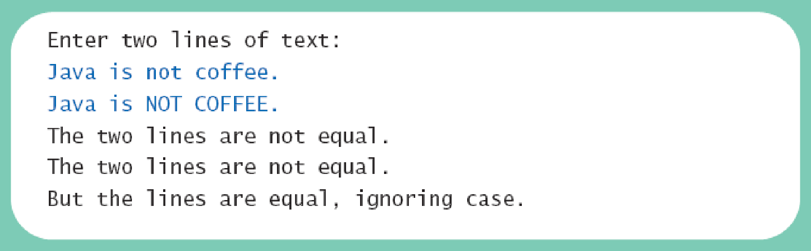
Testing Strings for Equality
Result

Slide 20
Comparing Strings
Strings can be compared using method compareTo.
String.compareTo method
Syntax
String_1.compareTo(String_2)
Returns
a negative number if String_1 precedes String_2
zero if the two strings are equal
a positive number of String_2 precedes String_1.

Slide 21
Comparing Strings
compareTo can be combined with methods toUpperCase or toLowerCase.
Ex) String1.toUpperCase().compareTo(String2.toUpperCase())
Ex)
String s1 = "Hello";
String lowerS1 = s1.toLowerCase();
String s2 = "hello";
if (s1.compareTo(s2)) == 0)
System.out.println("Equal!");

Slide 22
Nested Statements
An if-else statement can contain any sort of statement within it.
if (Boolean_Expression_1)
if (Boolean_Expression_2)
Statement_1;
else
Statement_2;
else
if (Boolean_Expression_3)
Statement_3;
else
Statement_4;;

Slide 23
Nested Statements
Each else is paired with the nearest unmatched if.
If used properly, indentation communicates which if goes with which else.
Braces can be used like parentheses to group statements.

Slide 24
Nested Statements
Subtly different forms
First Form
if (a > b) { if (c > d) e = f } else g = h;
Second Form
if (a > b) if (c > d) e = f else g = h;
// oops

Slide 25
Compound Statements
When a list of statements is enclosed in braces ({}), they form a single compound statement.
A compound statement can be used wherever a statement can be used.
Ex)
if (total > 10)
{
sum = sum + total;
total = 0;
}

Slide 26
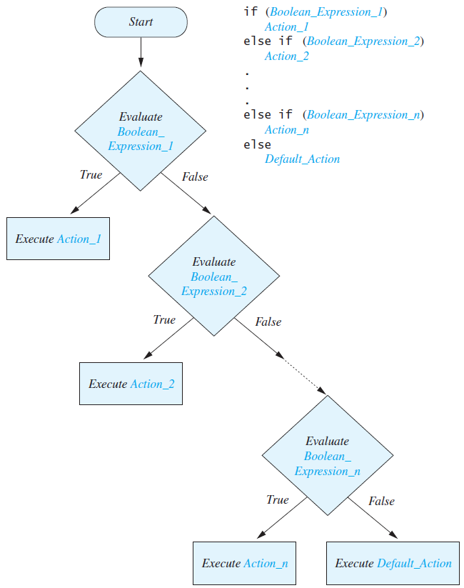
Multibranch if-else Statements
Syntax
if (Boolean_Expression_1)
Statement_1
else if (Boolean_Expression_2)
Statement_2
else if (Boolean_Expression_3)
Statement_3
else if …
…
else
Default_Statement

Slide 27
Multibranch if-else Statements
import java.util.Scanner;
public class Grader
{
public static void main (String [] args)
{
int score;
char grade;
System.out.println ("Enter your score: ");
Scanner keyboard = new Scanner (System.in);
score = keyboard.nextInt ();
if (score >= 90)
grade = 'A';
else if (score >= 80)
grade = 'B';
else if (score >= 70)
grade = 'C';
else if (score >= 60)
grade = 'D';
else
grade = 'F';
System.out.println (
"Score = " + score);
System.out.println (
"Grade = " + grade);
}
}

Slide 28
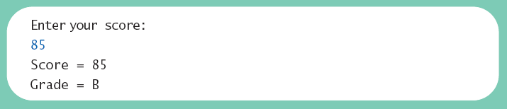
Multibranch if-else Statements
Result

Slide 29
Multibranch if-else Statements
Equivalent code
if (score >= 90)
grade = 'A';
else if ((score >= 80) && (score < 90))
grade = 'B';
else if ((score >= 70) && (score < 80))
grade = 'C';
else if ((score >= 60) && (score < 70))
grade = 'D';
else
grade = 'F';

Slide 30
The Conditional Operator
if (n1 > n2)
max = n1;
else
max = n2;
can be written as
max = (n1 > n2) ? n1 : n2;
The ? and : together are call the conditional operator (ternary operator)
The conditional operator is useful with print and println statements.
System.out.print("You worked " + hours + ((hours > 1) ? "hours" : "hour"));

Slide 31
The exit Method
Sometimes a situation arises that makes continuing the program pointless.
A program can be terminated normally by System.exit(0).
if (numberOfWinners == 0) {
System.out.println("Error: Dividing by zero.");
System.exit(0);
} else {
oneShare = payoff / numberOfWinners;
System.out.println("Each winner will receive $" + oneShare);
}

Slide 32
Agenda
The if-else statement
The type boolean
The switch statement

Slide 33
The Type boolean
The type boolean is a primitive type with only two values: true and false.
Boolean variables can make programs more readable.
if (systemsAreOK)
instead of
if((temperature <= 100) && (thrust >= 12000)
&& (cabinPressure > 30) && …)

Slide 34
Boolean Expressions and Variables
Variables, constants, and expressions of type boolean all evaluate to either true or false.
A boolean variable can be given the value of a boolean expression by using an assignment operator.
boolean isPositive = (number > 0);
...
if (isPositive) ...
Naming boolean variable
Good examples - isPositive or systemsAreOk
Bad examples - numberSign or systemStatus

Slide 35
Precedence Rules
Parentheses should be used to indicate the order of operations.
When parentheses are omitted, the order of operation is determined by precedence rules.
Operations with higher precedence are performed before operations with lower precedence.
Operations with equal precedence are done left-to-right (except for unary operations which are done right-to-left).

Slide 36
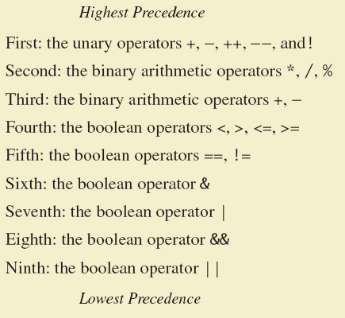
Precedence Rules

Slide 37
Precedence Rules
In what order are the operations performed?
score < min/2 - 10 || score > 90
score < (min/2) - 10 || score > 90
score < ((min/2) - 10) || score > 90
(score < ((min/2) - 10)) || score > 90
(score < ((min/2) - 10)) || (score > 90)

Slide 38
Short-circuit Evaluation
Sometimes only part of a boolean expression needs to be evaluated to determine the value of the entire expression.
If the first operand associated with an || is true, the expression is true.
If the first operand associated with an && is false, the expression is false.
This is called short-circuit or lazy evaluation.

Slide 39
Short-circuit Evaluation
Short-circuit evaluation is not only efficient, but sometimes essential!
A run-time error can result, for example, from an attempt to divide by zero.
if(sum/number > 5)
if((number != 0) && (sum/number > 5))

Slide 40
Input and Output of Boolean Values
Ex)
boolean booleanVar = false;
System.out.println(booleanVar);
System.out.println("Enter a boolean value:");
Scanner keyboard = new Scanner(System.in);
booleanVar = keyboard.nextBoolean();
System.out.println("You entered " + booleanVar);
Result
false
Enter a boolean value: true // the user typed true
You entered true

Slide 41
Agenda
The if-else statement
The type boolean
The switch statement

Slide 42
The switch Statement
The switch statement is a multiway branch that makes a decision based on an integral (integer or character) expression.
Java 7 allows String expressions
switch(Controlling_Expression)
{
case Case_Label:
Statements;
break;
case Case_Label:
…
default:
…
}

Slide 43
The switch Statement
The list is searched for a case label matching the controlling expression.
The action associated with a matching case label is executed.
The action for each case typically ends with the word break.
If no match is found, the case labeled default is executed.
The default case is optional, but recommended, even if it simply prints a message.
Repeated case labels are not allowed.

Slide 44
Enumerations
Consider a need to restrict contents of a variable to certain values
Ex) days in a week, HGU building names, …
An enumeration lists the values a variable can have
Ex) enum MovieRating { E, A, B }
MovieRating rating; rating = MovieRating.A;
Internally, enumeration values are treated as integers.
➔ Can be used for controlling expression of switch statement

Slide 45
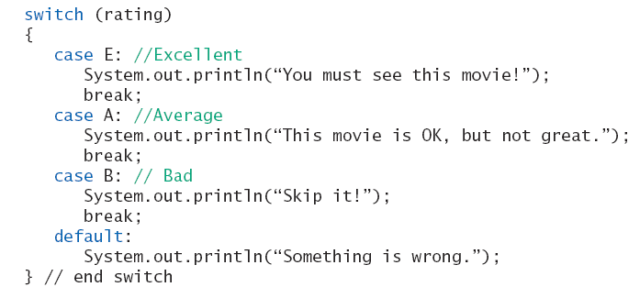
Enumerations
Now possible to use in a switch statement

Slide 46
Reading enum with Scanner Object
import java.util.Scanner;
public class Test {
enum Days { SUN, MON, TUE, WED, THU, FRI, SAT };
public static void main(String args[]){
Days a;
System.out.println("What's your favorite day? ");
Scanner keyboard = new Scanner(System.in);
a = Days.valueOf(keyboard.next());
System.out.println("Your favorite day is " + a);
}
}

